Slide 1
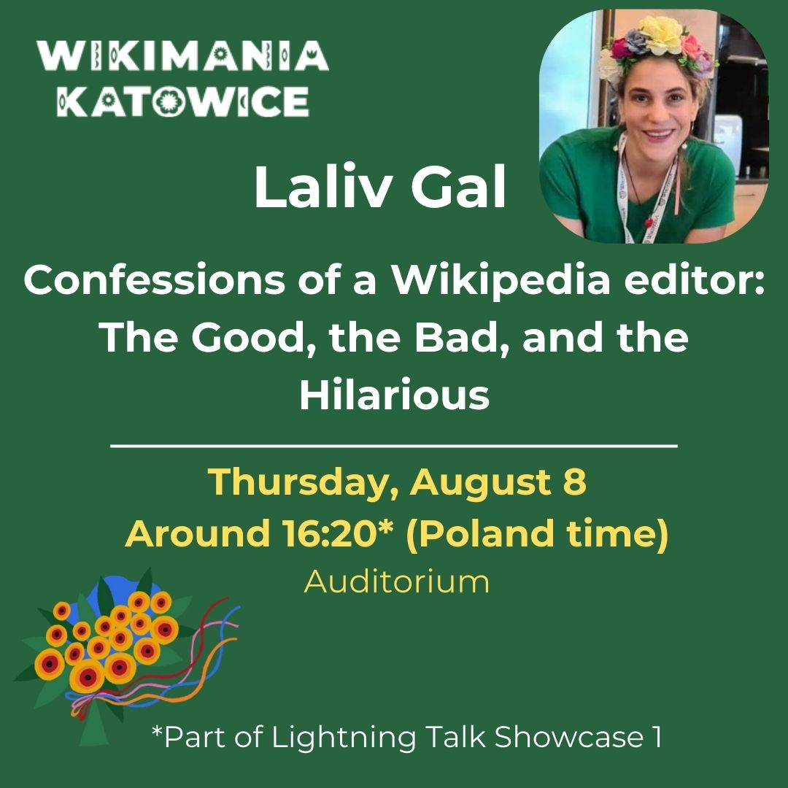
Laliv g / Israel
Notes:
Imagine turning street food into a global phenomenon or using Wikipedia to heal a broken heart. Welcome to the crazy world of editing Wikipedia, everyone! My name is Laliv and I am a wiki-woman. I am passionate about women articles and I am trying to do my best in order to minimize the gender gap in Wikipedia. I will share some stories about the human element behind Wikipedia; most of them are women articles

Slide 2
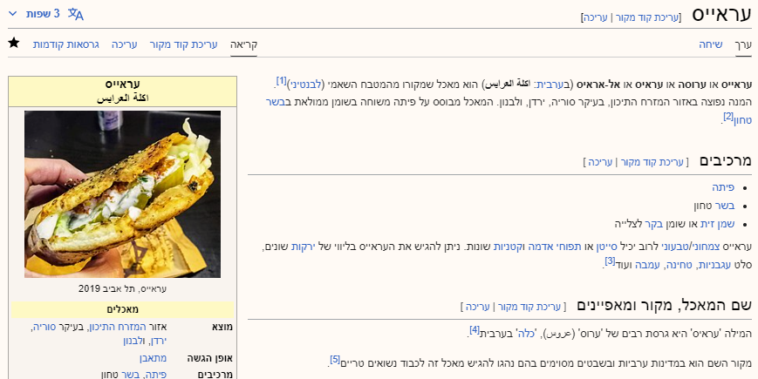
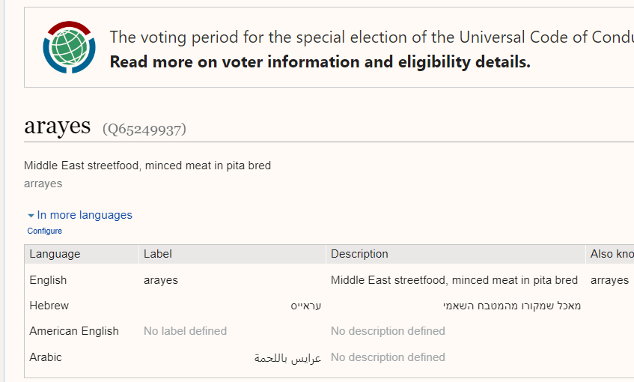
The Good
Notes:
Stockholm 2019 was my first Wikimania ever. I presented a Hebrew article that I wrote. That article did not exist in any other language at that time and it was very hard to find sources for it. When I got back home, I was super excited to get emails from other wikipedians that translated that article to their own language! Now, it is in three different languages, other than Hebrew. That is something I love about Wikipedia: the power of collaboration!

Slide 3
The Sad
Notes:
Another experience, touching the sad side of the human element: One morning I was drinking my coffee when I got a phone call from an old friend. Since I have not heard from her in the last two decades, I was curious: what brought her back to my life? She asked if it is ok to contact me with someone who just lost her sister. For the memorial, that person wanted her sister to have a Wikipedia article. She was a famous radio broadcaster in Israel, and as I started to write the article, I realized that her voice was the soundtrack of my childhood and when I grew up, I drove miles with her voice on my car radio. Working on this article was my way to honor someone who shaped my life.

Slide 4
The Unexpected
Notes:
) Ready for the surprising one? A Facebook friend that I have never met in person DM-ed me one day. He told me that he decided to end his long time relationship with his wife, a well-known artist. However, before that, he was thinking about a ‘farewell present’: A Wikipedia article! I wrote the article and I explained to that friend that for the portrait picture I would have to contact his soon to be ex-wife. He asked me not to mention his name. The article was published and that person and I were still Facebook friends up until he started to post up with his new girlfriend! And that artist? She was not even aware that she got a Wikipedia article as a goodbye gift (Her full name is available upon request)

Slide 5
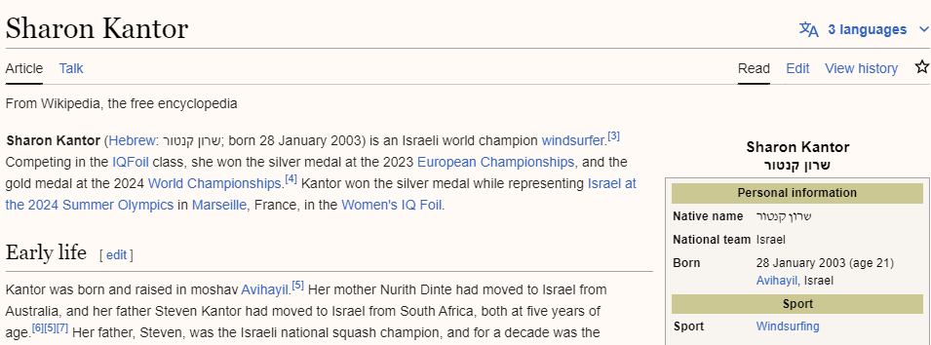
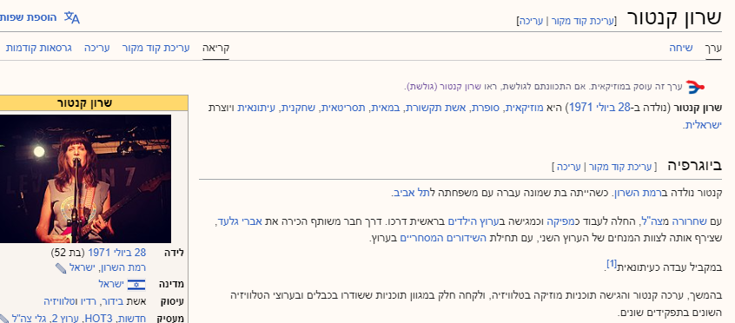
The Last one
Notes:
If we have time for one more, look at those two women: Both are famous, each in her own field: One is a musician and a journalist and the other is world champion windsurfer, and since Saturday an Olympic medalist! Neither had a Wikipedia article. What is curious is that both share the exact same name – Sharon Kantor, despite having different life paths! So I wrote both articles, and added this template. The journalist even posted about it in the newspaper!

Slide 6
In loving memory of Deror Avi Lin
Wrote more than 8,752 articles
Wikimedia Laureate winner, 2022
Deror wrote over 2% of the entire Hebrew Wikipedia.
He participated in many 100 wikidays challenges and contributed thousands of images.
He was also a key organizer of multiple Wikimanias.
16.10.1974-6.5.2023

Slide 7
Share your thoughts
on my IG story
Thank you for listening
Notes:
Have you wrote an article that made you think about the human element behind Wikipedia? Share yours in my Instagram story; let us celebrate the wonderful world of Wikipedia together! Thank you everyone

Slide 8
Resources
Deror
https://commons.wikimedia.org/wiki/Category:Deror_Avi#/media/File:Tel_Aviv_-_Wikipedia's_15th_Birthday_celebration_IMG_8270.JPG
Wikimedia Israel logo
https://commons.wikimedia.org/wiki/File:Wikimedia_Israel.png
All other
https://pixabay.com/

